Slide 1

Cloudgineers
Jackson Gray
Carnell Greenfield
Jaden Jefferson
Nick Miller
Kelly Payne

Slide 2
Summary
Method: Use OpenStack and Kubernetes to set up a private cloud
Process: Install and configure software
Goal: Create a private cloud

Slide 3
Kubernetes & OpenStack
OpenStack
Set of open-source cloud computing software components
Which manage
Compute Resources
Storage
Orchestration
And many more cloud computing services.
Kubernetes
An open-source container management tool
Automates
Container deployment
Container scaling and descaling
Container load balancing.

Slide 4
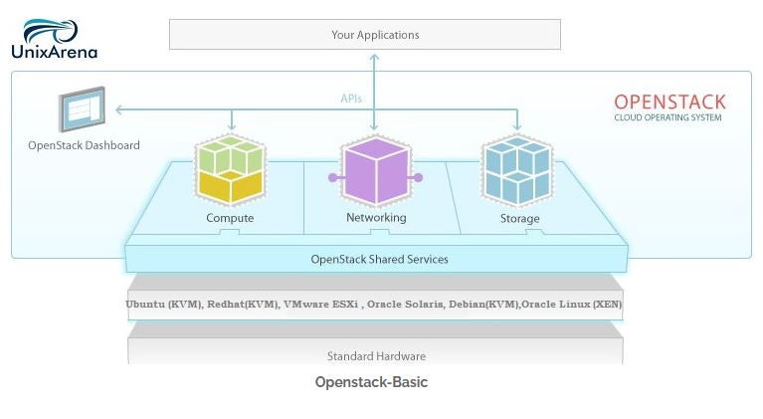
Basic Architecture

Slide 5
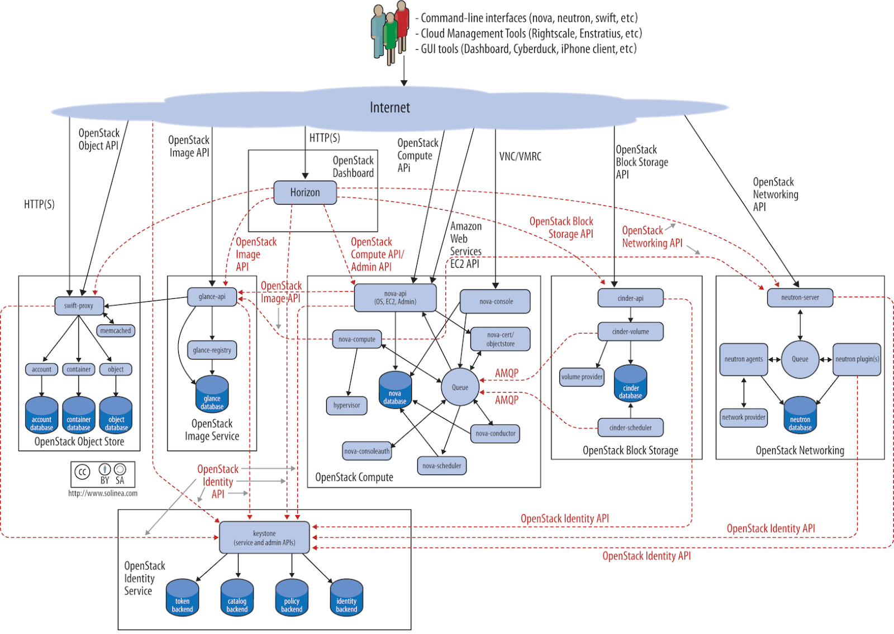
Complete OpenStack Architecture Model

Slide 6
Epics Worked on Since Last Meeting (Still In Cycle 2)
Linux Operating System
Dell Remote Access Controller
Server Network
Rack Cabinet
OpenStack Playground

Slide 7
Future Epics Being Pulled In For Cycle 3
ALL previous features
OpenStack Playground - continuation
Base OpenStack Deployment
User Dashboard, Identity Access Management, Networking Service, Computing Service, Imaging Service, Block Storage Service, Object Storage Service

Slide 8
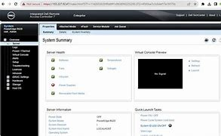
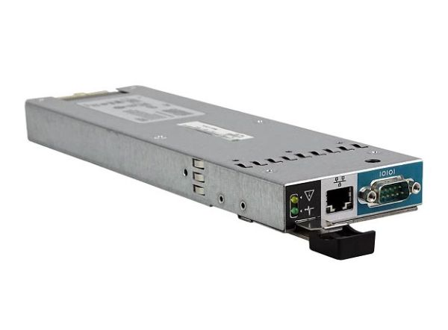
Dell Remote Access Controller
Installation and Walkthrough
RAID Configuration (Reassessment)
IDRAC Server Profile
Hardware Monitoring
Virtual Media

Slide 9
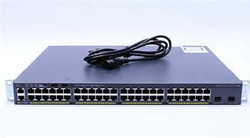
Server Network
Get IP Address Configured
Get Switch Up and Running
VLAN Configurations
Internet Access through Wall Port
Server Port-Based Address Allocation
Connect Servers to VLAN
Setting up the overall physical and virtual network infrastructure for the servers and cloud platforms to be hosted on.

Slide 10
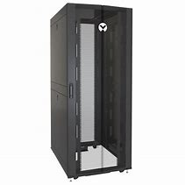
Server Room Setup: Rack Cabinet
Access Point to Enter Cabinet
Stabilizing Roll Out Trays
Inserting Dell Servers
Inserting Cisco Switch

Slide 11

OpenStack Playground
Provide a place of learning for both future OpenStack Sysadmins and Users
Miniature OpenStack environment to use as a playground.
A mini single node version of OpenStack for future engineers and developers to use and learn OpenStack in a supervised environment.
Users of this platform will learn how use key components such as Horizon, Nova, Keystone, Glance, Neutron, and Cinder.
POC: DevStack
Single Node Deployment
Lab Creation

Slide 12
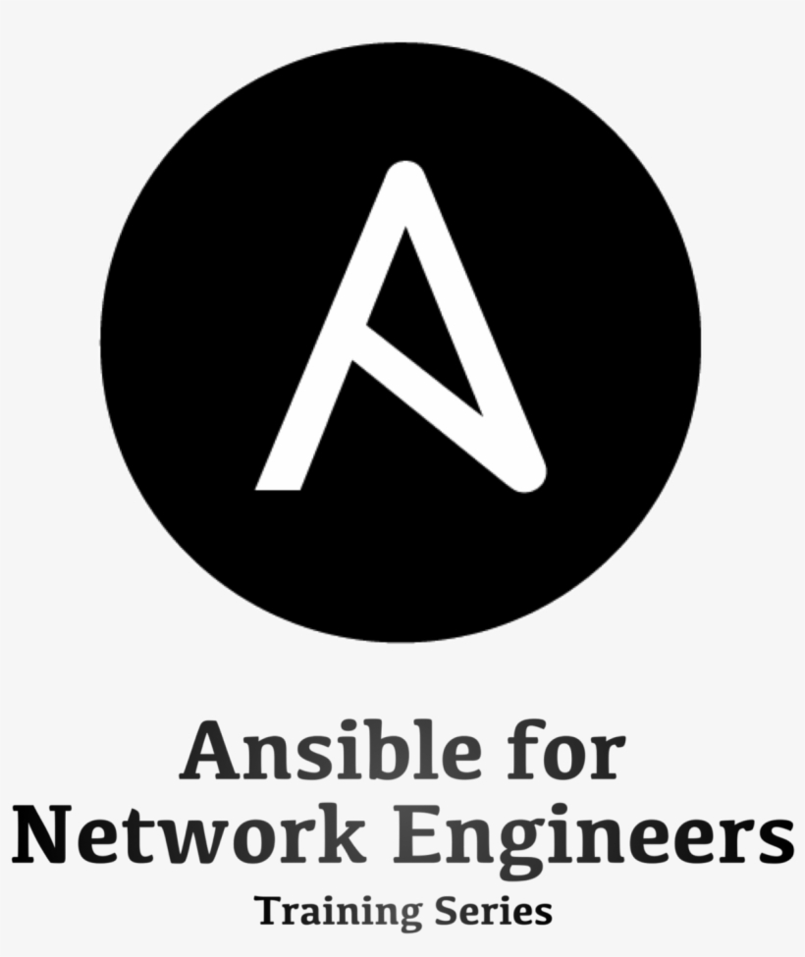

Base OpenStack Deployment
Currently waiting on wall port access as switch has been blacklisted from University Network.
Hands are tied by UITS
Further assessment and team discussion needed on definition of done for 'Base' deployment.
Will begin next sprint (4) on March 6th

Slide 13
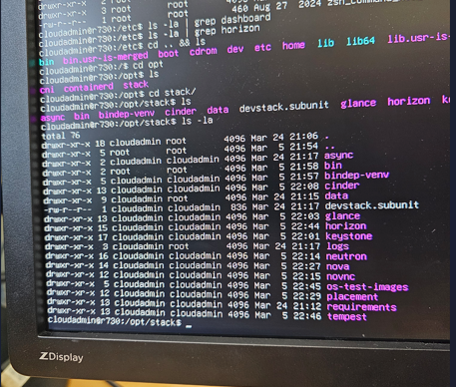
Contents of DevStack

Slide 14
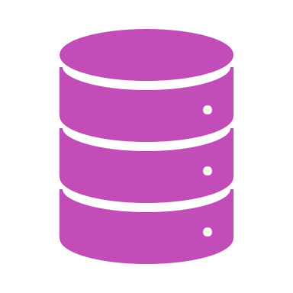
Other Epics
OpenStack Components
Continuous Learning
Continuous Improvements

Slide 15
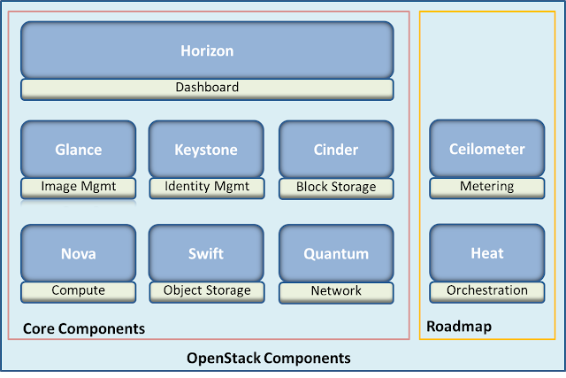
Other Epics/Features
Configuration and installment of each key component in OpenStack
Will begin sprint 5 on March 20th
User Dashboard
Identity Access Management
Networking Service
Computing Service
Imaging Service
Block Storage Service
Object Storage Service
Neutron

Slide 16

Continuous Learning
We have continuous learning as we investigate OpenStack and all the components that are included.
ThePhoto by PhotoAuthor is licensed under CCYYSA.

Slide 17

Continuous Improvements
Hardware Requests-1
As we progress, through our project we will include more task.
ThePhoto by PhotoAuthor is licensed under CCYYSA.

Slide 18

What did we learn?
How to tackle bugs facing common issues in DevStack
Using the Linux command line
Installing rails in the server rack
RAID levels
Encryption through Ubuntu Installation Wizard

Slide 19
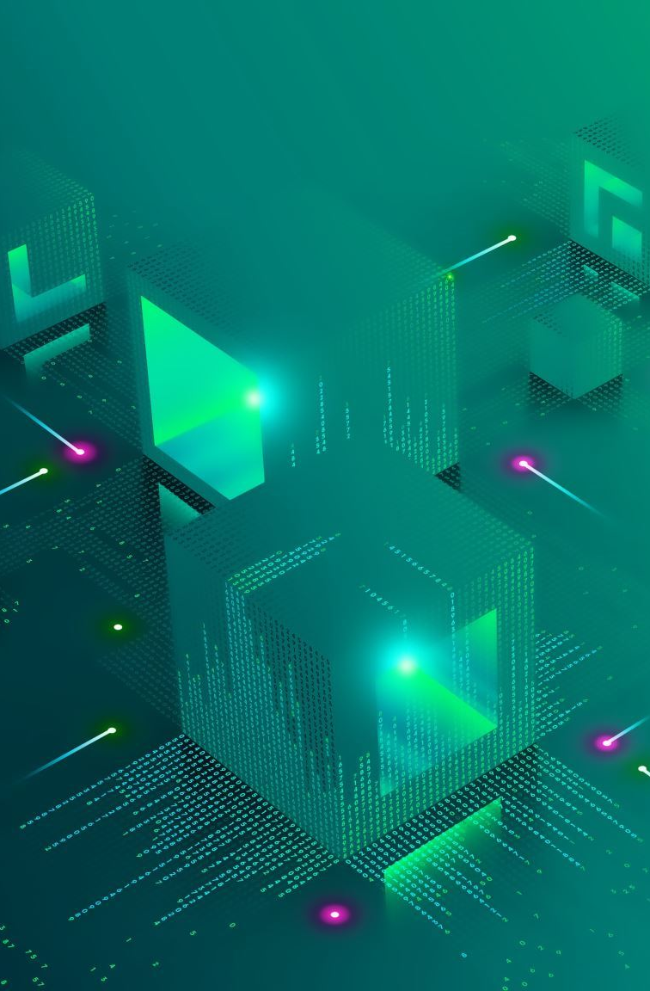
Conclusions
Using DevStack, we initialized OpenStack on server R730 as a single node deployment.
Our plans are to use the desktop for DevStack installation so we can separate DevStack and OpenStack.
The 710A will be the controller, the 710B will be used as the network, and the 730 will be used for compute and storage.

Slide 20
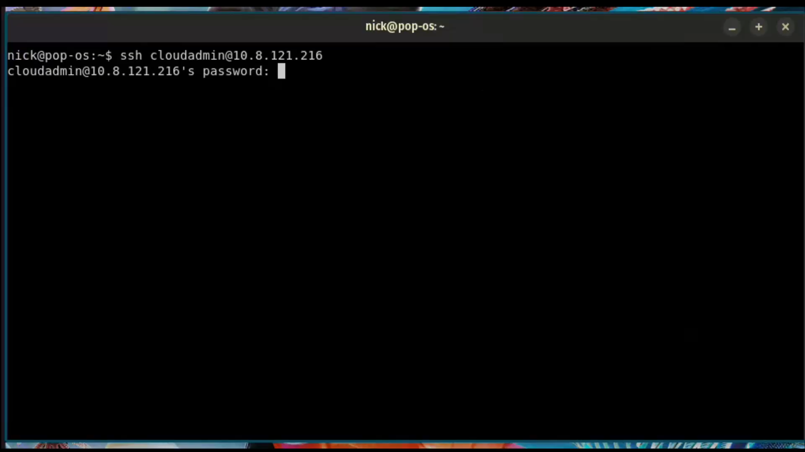
Demo Video
Video File

Slide 21

Q & A

